Slide 1
Electronic Devices and Circuits Lab 03 – ramp generator
Lab overview
Objective: The objective of this lab is analyze, simulate and assemble the pseudo ramp generator.

Slide 2
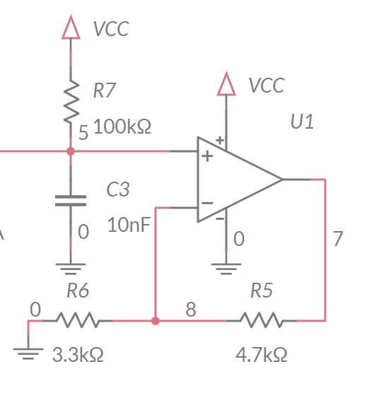
Pseudo ramp generator
The 10nF capacitor C3 charges towards VCC = 9V
Charges for 270us then reset (by 555 timer)
The charging is close to a straight line
Compare charging cap to a straight line in Excel

Slide 3
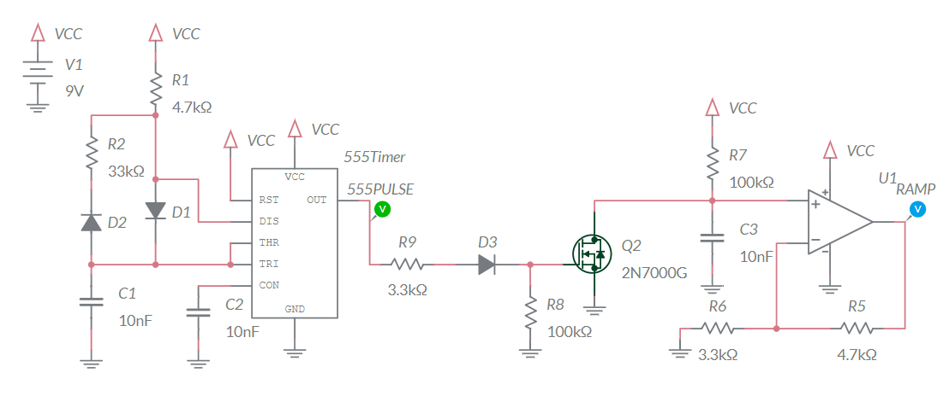
Simulation
Build in Multisim
Charge on capacitor is cleared by MOSFET
Do not include Schmitt Trigger Oscillator in simulation
Simulate to verify calculations

Slide 4
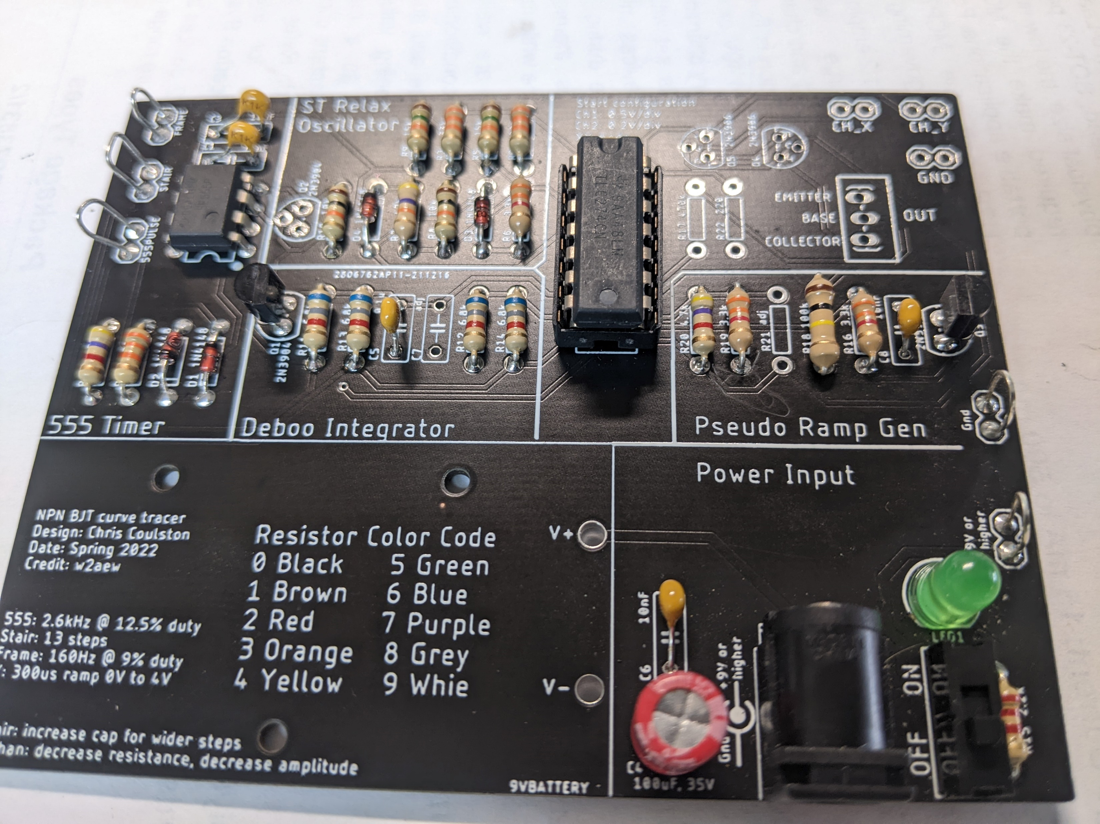
Assemble
Assemble
Annoying big 100k
2N7000 clears charge off cap

Slide 5
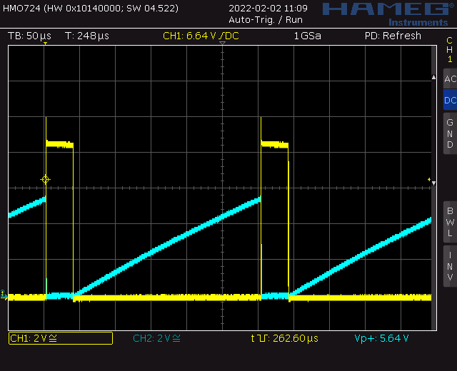
Test
Probe 555TIMER (yellow) and RAMP (blue)
RAMP is bottom terminal of
unoccupied R21 resistor

Slide 6
Turn in
Summary of analysis, simulation and assemble
Answer listed questions
Save solutions as PDF
Due before start of class next week
Every student builds their own board
Everyone brings their board to class

